Slide 1

Twitter Sentiment Analysis
Natural Language Processing
Brennan Mathis

Slide 2
Problem Statement
Use language in tweets to assess negative sentiment toward any brand or product
Notes:
Every second, on average, around 6,000 tweets are tweeted on Twitter, which corresponds to over 350,000 tweets sent per minute, 500 million tweets per day and around 200 billion tweets per year
Goal: Find a method to assess consumer sentiment toward product or brand using public tweets and language contained within tweets without individually assessing each tweet
Companies want to be able to maintain good relationship with consumers. Its 2020 and consumers, rather than calling customer service, will vent their frustrations on social media. I have developed a way to determine the sentiment regarding your company or a specific product from the perspective of consumers on twitter. This can also be used to assess competitors and their brands and products in order to keep up and surpass them by adapting accordingly. See what they do right or wrong, and implement as such. Or just find out what people like or dislike about your products, or brand. Stay ahead of product issues and stay ahead of the curve overall

Slide 3
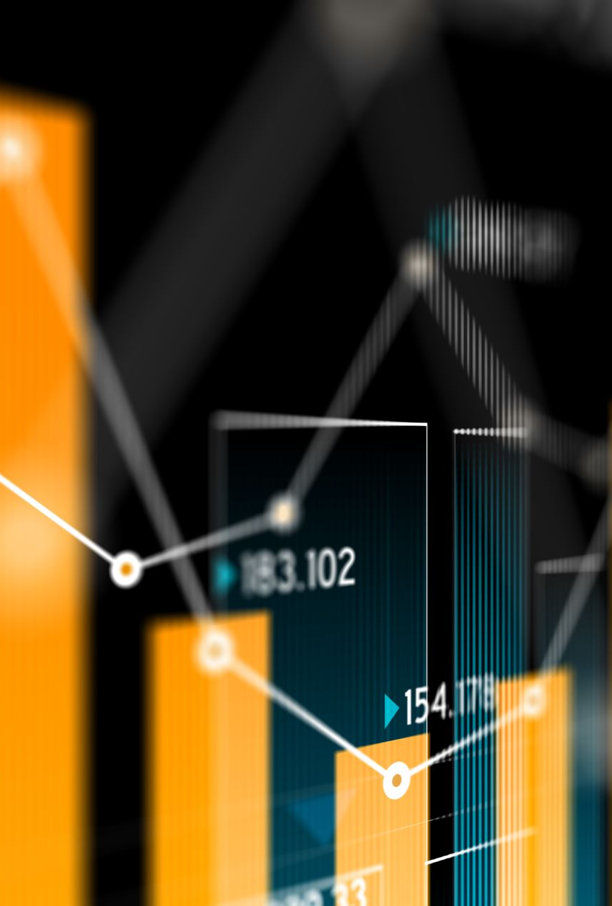
Business Value
Use machine learning to assess negative sentiment conveyed through social media
Notes:
Dataset specific to apple & android products, so brand names removed from tweets to remove bias toward product sentiment using only the language
toward brand and product to analyze sentiment so useful for any brand.
By providing sentiment analysis information obtained through tweets, informed decisions can be made implementing policy to continue positive sentiment
or execution of corrective action in the case of negative sentiment.
Save time and money, rather than wasting employees time on going through tweets individually, filter and assess this way

Slide 4
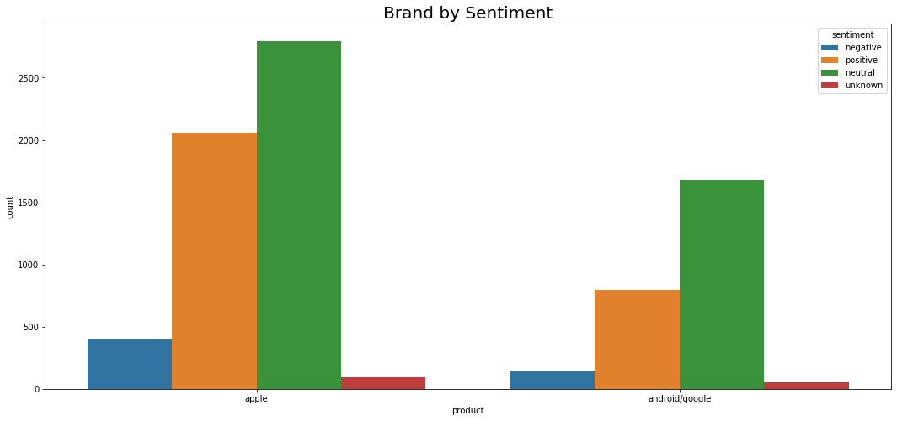
Factors Assessed
Tweet text
Sentiment
Term frequency
Notes:
Removed brand and product terms from tweets using stopwords removal for this as I was assessing the language toward the
Sentiment only, but this could be used to filter sentiment toward a specific product for a company releasing new products or
Performing customer satisfaction promises by listening to consumers
there were far more apple and apple product references in this dataset than android
Tfidf converted data
TF(t) = (Number of times term t appears in a document) / (Total number of terms in the document).
IDF: Inverse Document Frequency, which measures how important a term is. While computing TF, all terms are considered equally important.

Slide 5
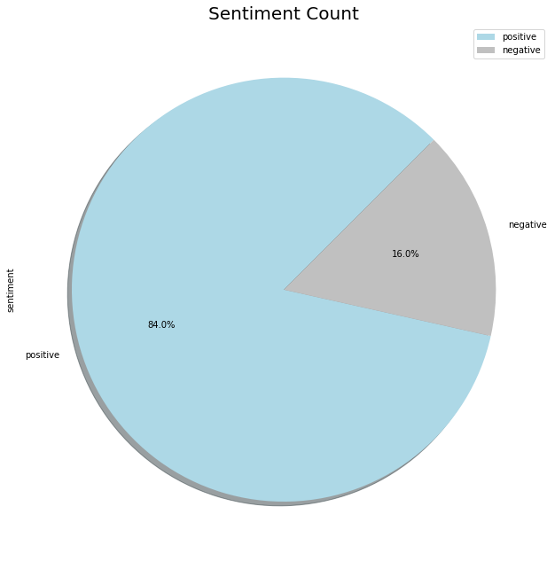
Dataset Info
CrowdFlower from dataworld.com
3403 tweets
5070 unique words/tokens
https://data.world/crowdflower/brands-and-product-emotions
Notes:
Human raters rated the sentiment in tweets in provided dataset.
Data was from sxsw in Austin
Removed those terms and brand/ product terms to provide accurate sentiment, this can be filtered to assess sentiment toward a specific product or brand only
Many overlapping terms existed s show later
Max length of tweets – 17 words

Slide 6
Dense Data Representation
Notes:
This graph displays the overlap of terms extracted from tweets. Many overlapping points, outliers are infrequent especially for negative sentiment
This is due to nature of the dataset and can be rectified with additional data
Additionally, when converting text to numeric datapoints, utilized ngrams (combinations of 2 words together) to give context to phrases that may be negative depending
On term occurring before or a word

Slide 7
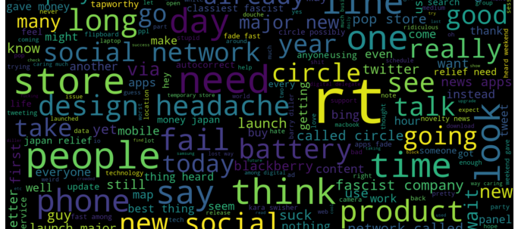
Negative terms
Notes:
Top 50 terms in negative tweets
Overlapping data frequently occurring in positive & negative sentiment
Notable negative terms include: battery, phone, launch in addition to obvious negative terms like fail, headache, and facist company

Slide 8
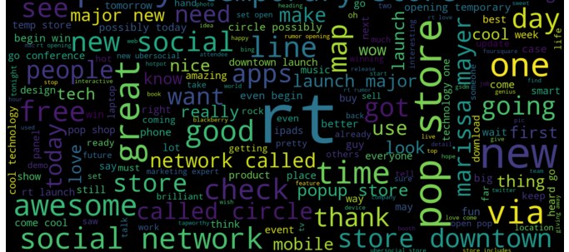
Positive terms
Notes:
Top 50 terms in positive tweets
Overlapping data frequently occurring in positive & negative sentiment
Examples include social network, store, rt , new
Notable terms include store, popup store, store downtown, should you want to see what stores seem to be doing something right
Marissa mayer is doing something right

Slide 9

Methodology
Statistical Analysis
Neural Network
Model Precision
Notes:
Analysis of precision focus on negative datapoints, positive bias made accuracy high but low precision so adjusted some weights and thresholds for analysis

Slide 10
Statistical Models Precision/Recall
Notes:
Complement bayes chosen model

Slide 11
Model Results
Notes:
Will be improved with additional data to process

Slide 12
Business Recommendations
Keep up with trends
Stay competitive
Predict & plan ahead
Collect more data
Notes:
Determine product trends and keep up with current needs
Assess competitor’s popularity and determine the why and how to stay competitive
Predict and plan according to consumer reactions
Collect variety of tweets for variety of related brands, products, events to produce a more accurate model
Maintain a presence on social media to show consumers that you care and hear them, and address their concerns verbally and through followup action

Slide 13
#Thankyou

